Slide 1
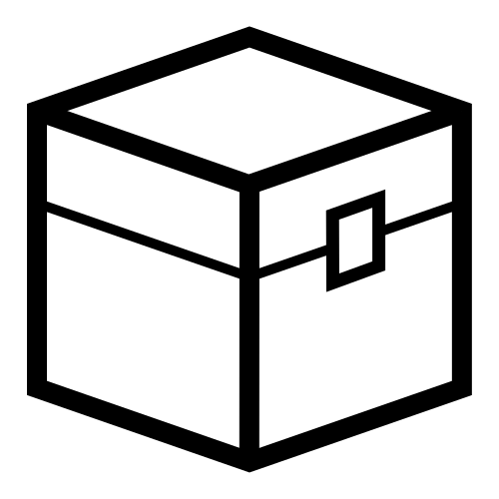
BETTER GUI
An animated menu
A simple menu-designing tool
Just a better GUI plugin

